Slide 1

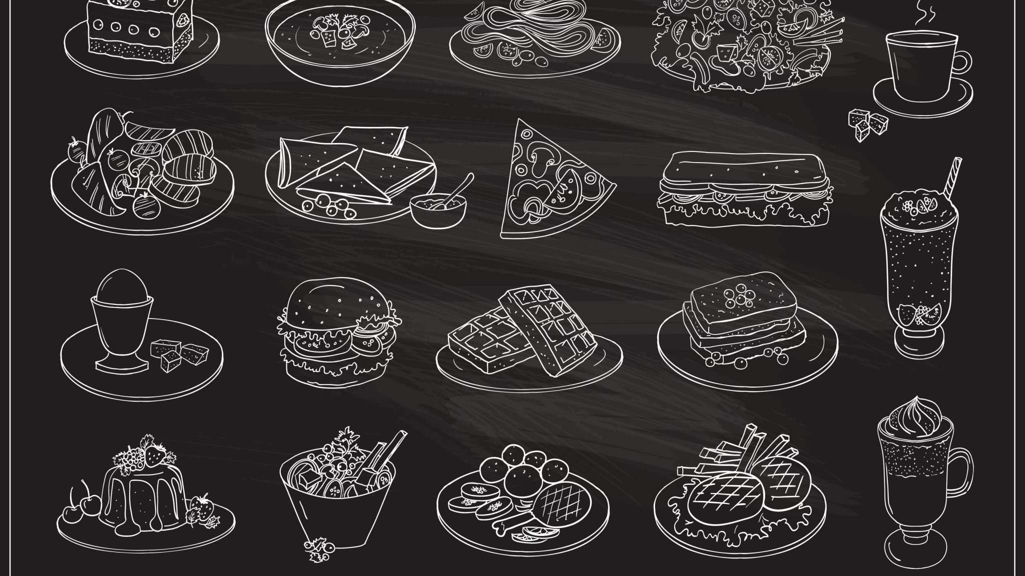




Restaurant Database Management System
Team Members
Minghui Qiu
Xiaoyang Cai
Manju Sharma
Kusha Choudhary

Slide 2
Problem Statement
All data is maintained manually, increasing the chances of error and complexity of maintenance.
The same data is entered every day, which is a redundant process.
No database available for the employees, customers, and the prime members.
There is no system of reserving the table online.
The food cannot be ordered online for delivery.
The option of going contactless in the restaurant during covid was not available.
Audit of inventory and transactions is difficult.

Slide 3
Objectives
Online reservation of the table.
Basis the past choices a custom menu will be available to each customer along with the traditional menu.
Free delivery of birthday cake for the prime members.
Contactless delivery of food.
Assignment of delivery boys for specific areas.
Online checkout at the table, ensuring no contact

Slide 4
Design

Slide 5
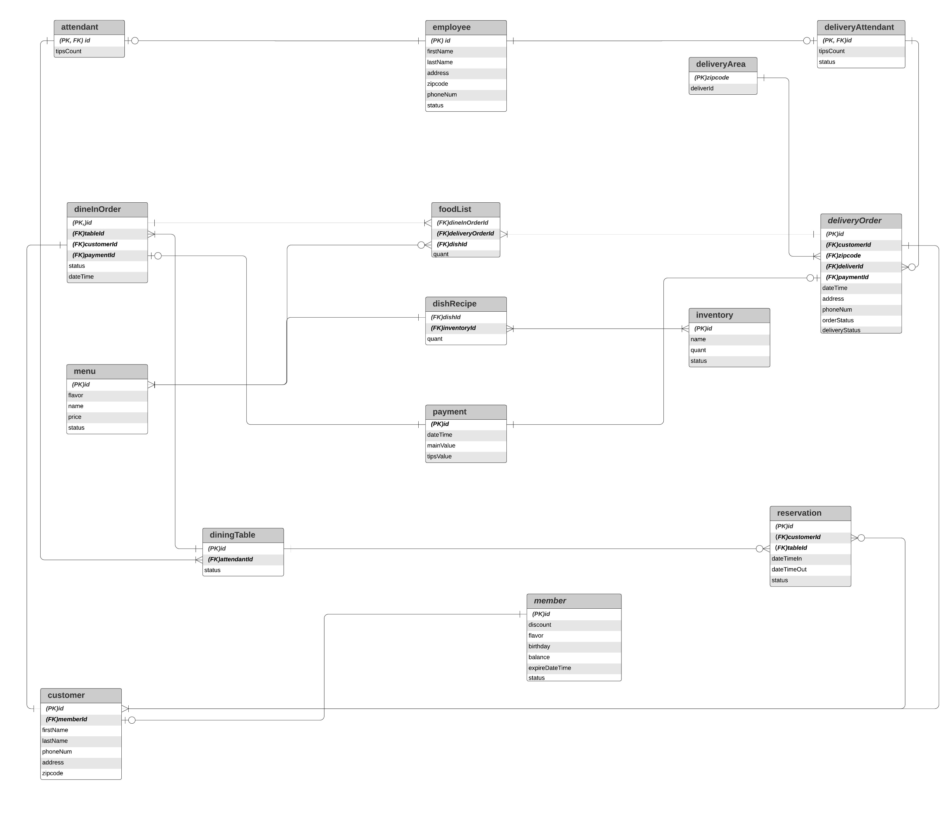

Slide 6
Implementation

Slide 7
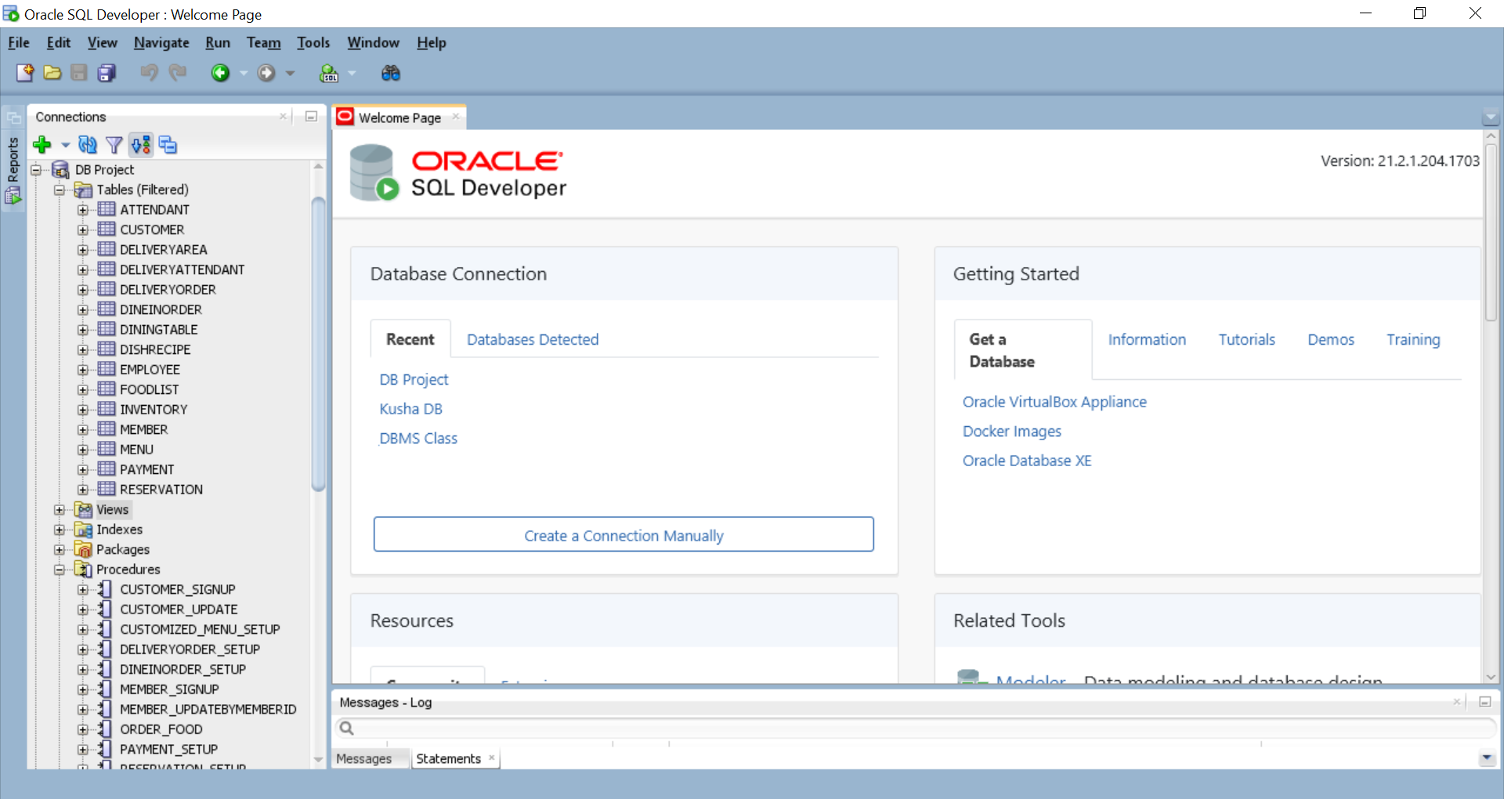
Tables and Data
Count – 15

Slide 8
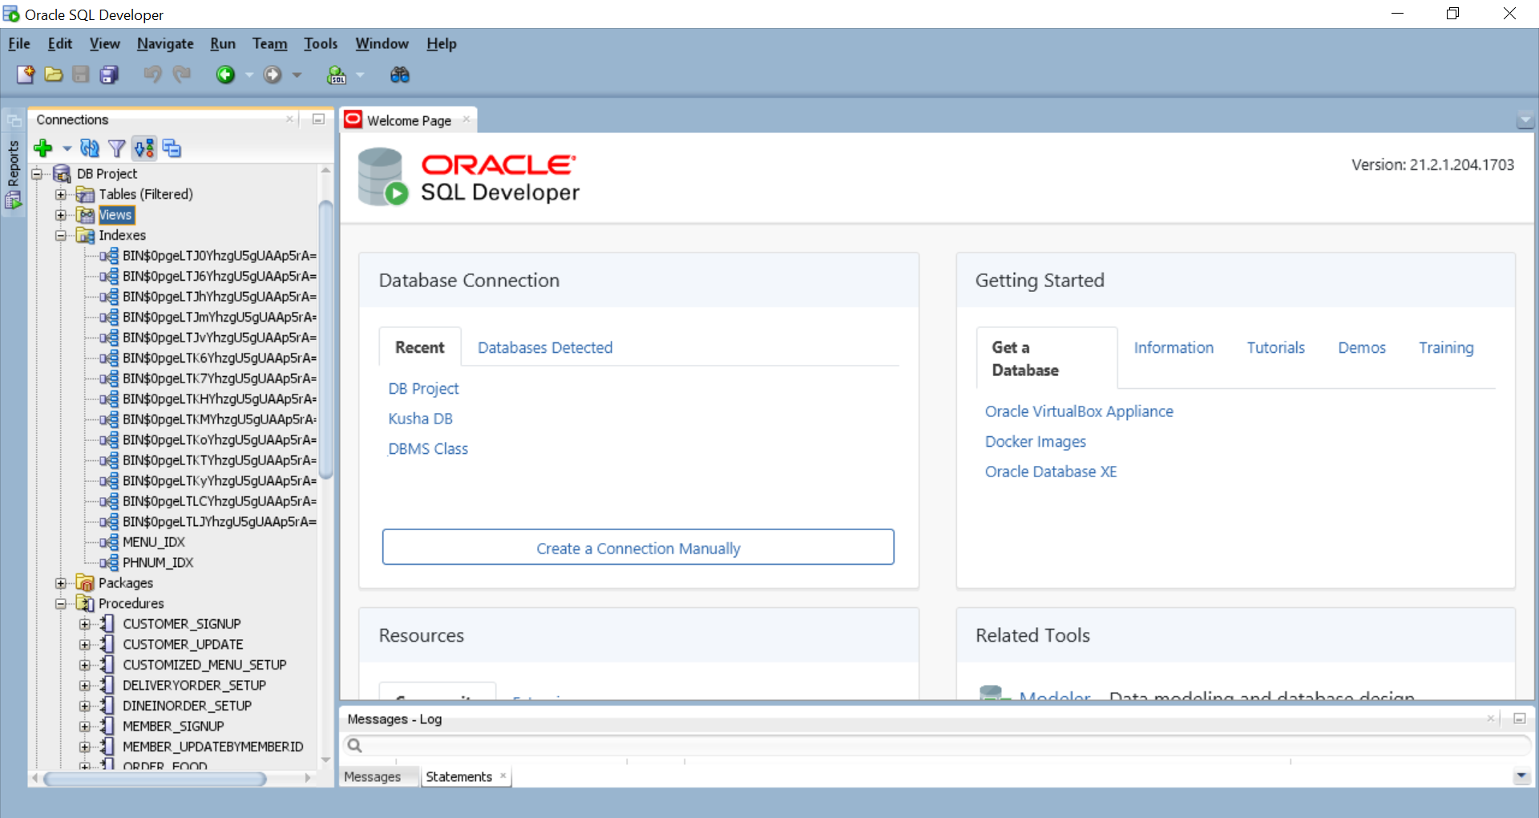
Index
Count – 2 custom index
Menu_IDX – This index is created on the
name of menu items on menu table
Phnum_IDX – This index is created on the
Phone number on the customer table

Slide 9
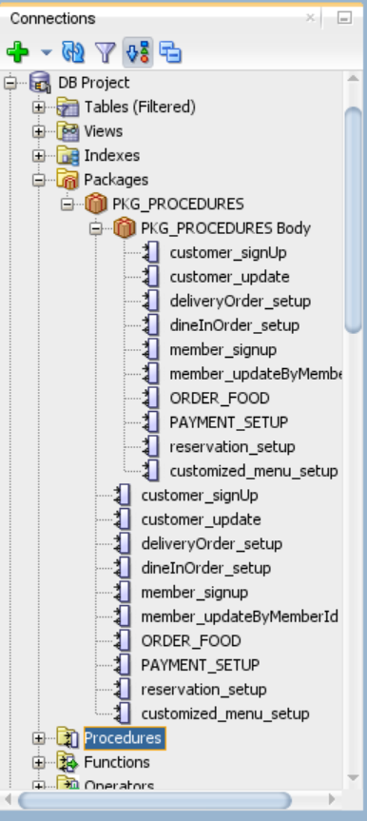
Package
Count – 1 Package of Procedures

Slide 10
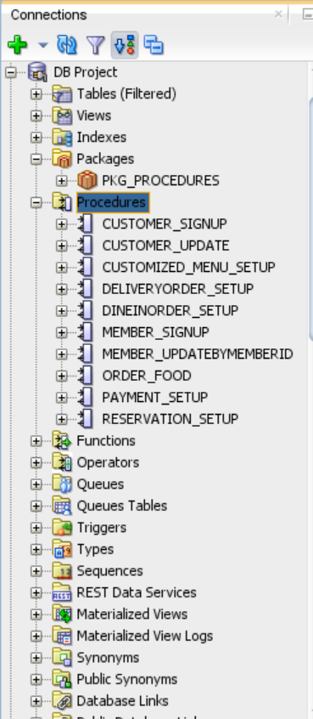
Procedures
Count – 10
Customer_SignUp – This procedure is used for signing up
A new customer
Customer_Update – This procedure is used for updating
an existing customer
DeliveryOrder_Setup – This procedure is used for creating
a delivery order

Slide 11
Procedures
Member_Signup – This procedure is used for signing up a new member
Member_UpdateByMemberId – This procedure is used for updating an existing member
Order_Food – This procedure is used to create the order, requested by the customer, it can be either dine in or delivery.

Slide 12
Procedures
DineInOrder_Setup – This procedure is used for creating
a dine in order
Reservation_Setup – This procedure is used to book a table with status ‘available’, changing the status to ‘occupied’
Customized_Menu_Setup – This procedure is used to create a customized menu for a customer basis their past choices
Payment_Setup – This procedure is used to generate a payment and payment id once the order is completed

Slide 13
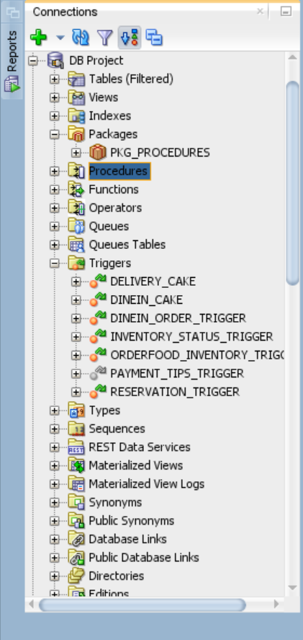
Triggers
Count – 6
Delivery_Cake – This trigger is run when it’s a customers
Birthday. A cake will be delivered to the customer
Dinein_Cake – This trigger is executed when a customer
is dining in on his/her birthday. A cake will be served to
the customer

Slide 14
Triggers
Dinein_Order_Trigger – This trigger is executed to when
a table is reserved and will change the status from
‘available’ to ‘occupied’
Inventory_Status_Trigger – This trigger is executed when the stock in the inventory is over, setting the inventory status to ‘out of stock’ and quantity of the item to 0.

Slide 15
Triggers
Orderfood_Inventory_Trigger – This trigger is executed to update the inventory everytime an order is placed as with each order there will be consumption of items.
Reservation_Trigger – This trigger is executed when a customer tries to reserve a table when a reservation already exists, avoiding overlapping reservations

Slide 16
Users
1. Admin
All level of access for all the entities.
2.. Manager
Read only access to payment, dishRecipe , orderList , customer.
READ/WRITE/UPDATE access to employee , inventory , menu , dinningTable , reservation.
3. Attendant
No access to payment, inventory ,customer , dishRecipe.
Read Only access to reservation, attendant , OrderList ,dineInOrder, menu.
READ/WRITE/UPDATE access to employee.

Slide 17
Users
4. Delivery Agent
No access to payment, inventory ,customer , dishRecipe.
Read Only access to deliveryOrder, deliveryArea.
READ/WRITE/UPDATE access to employee.
5. Customer
No access to inventory ,customer , dishRecipe ,
Read Only access to the menu , payment only.
READ/WRITE/UPDATE access to customer.

Slide 18
Reports

Slide 19
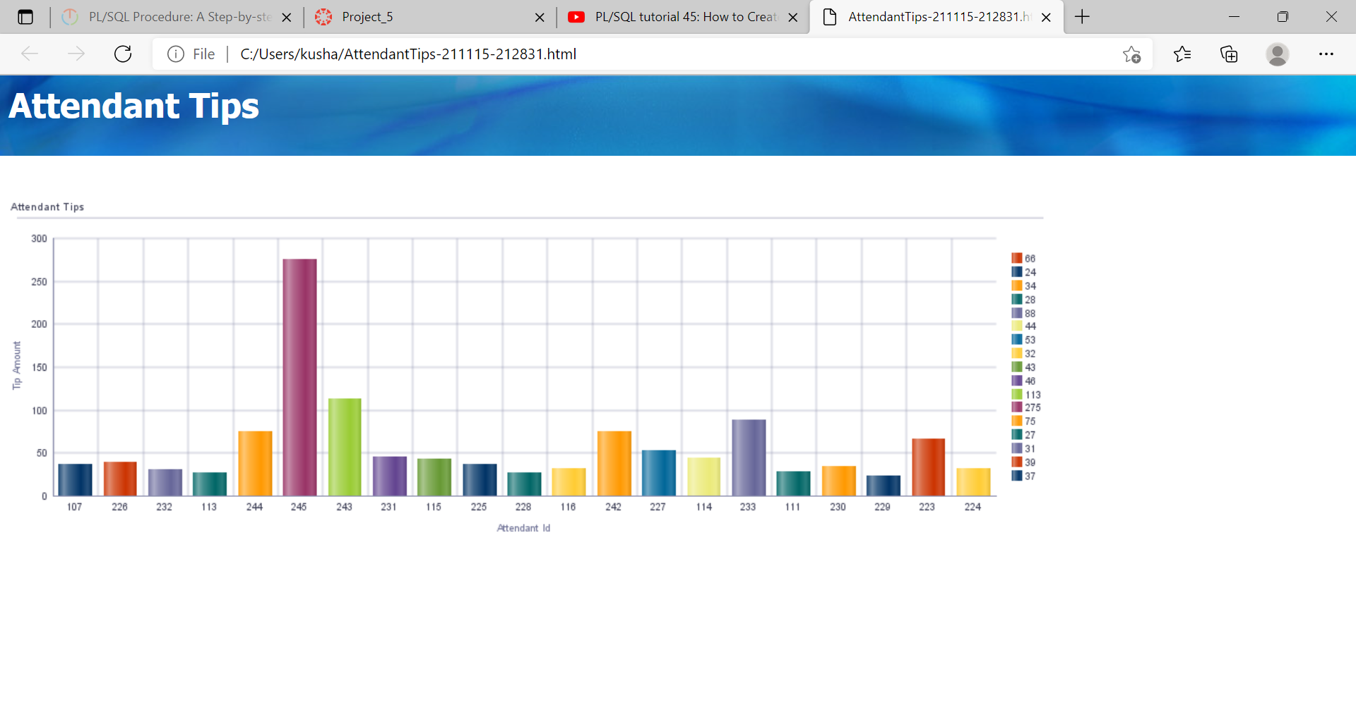
Attendant Tips Basis the Attendant ID

Slide 20
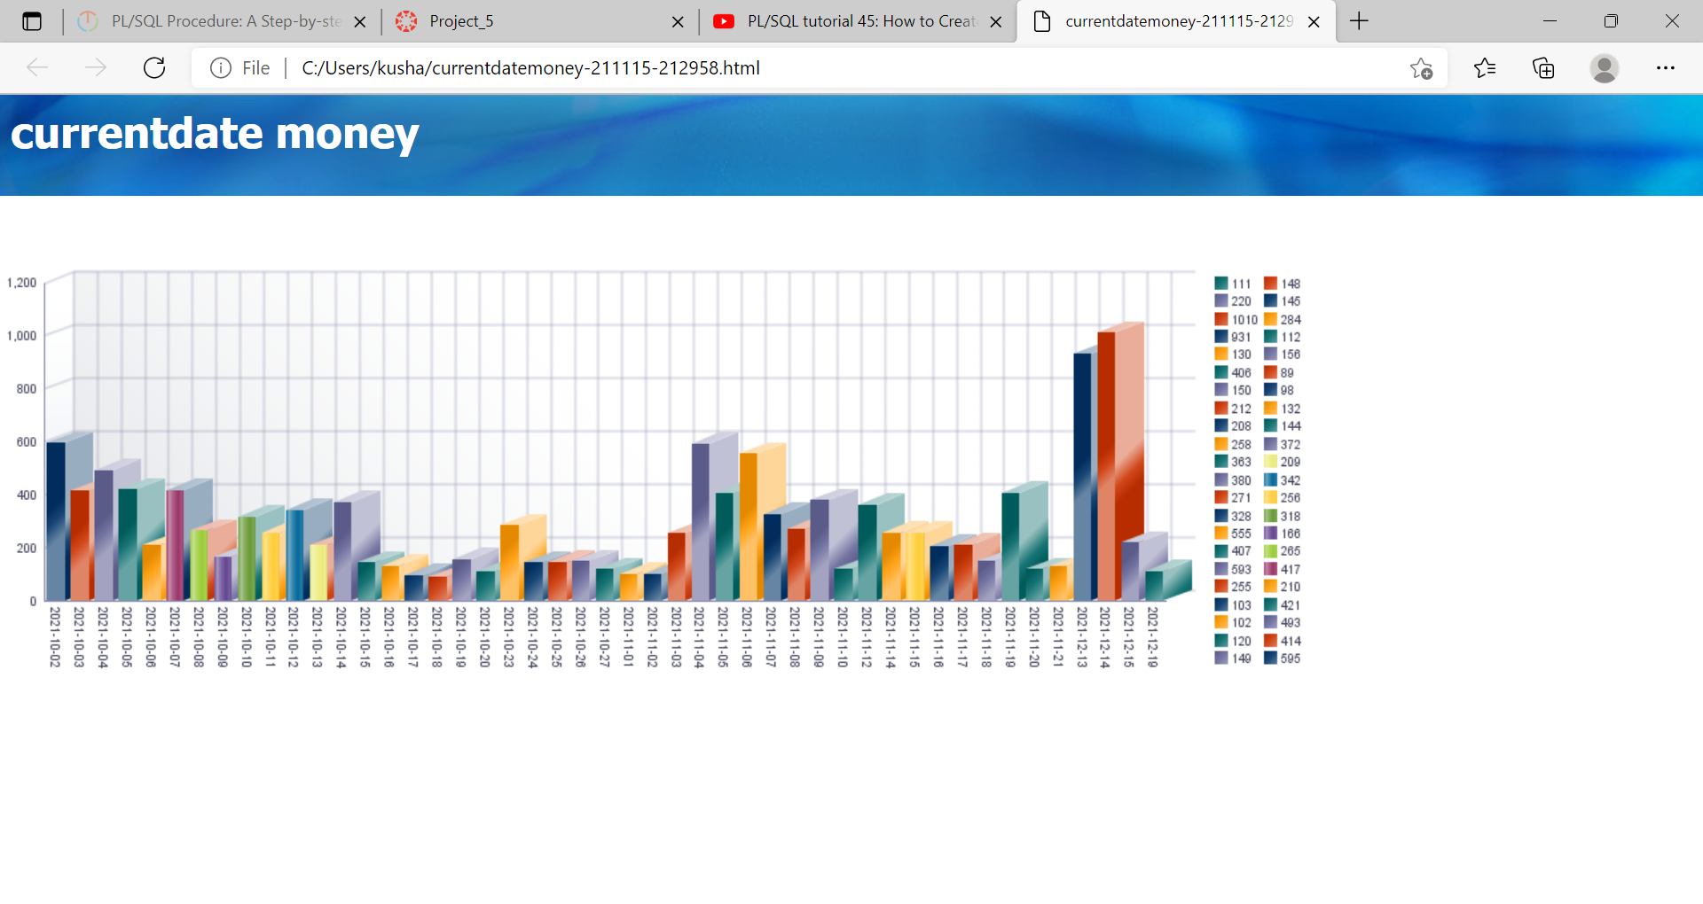
Current Date Money

Slide 21
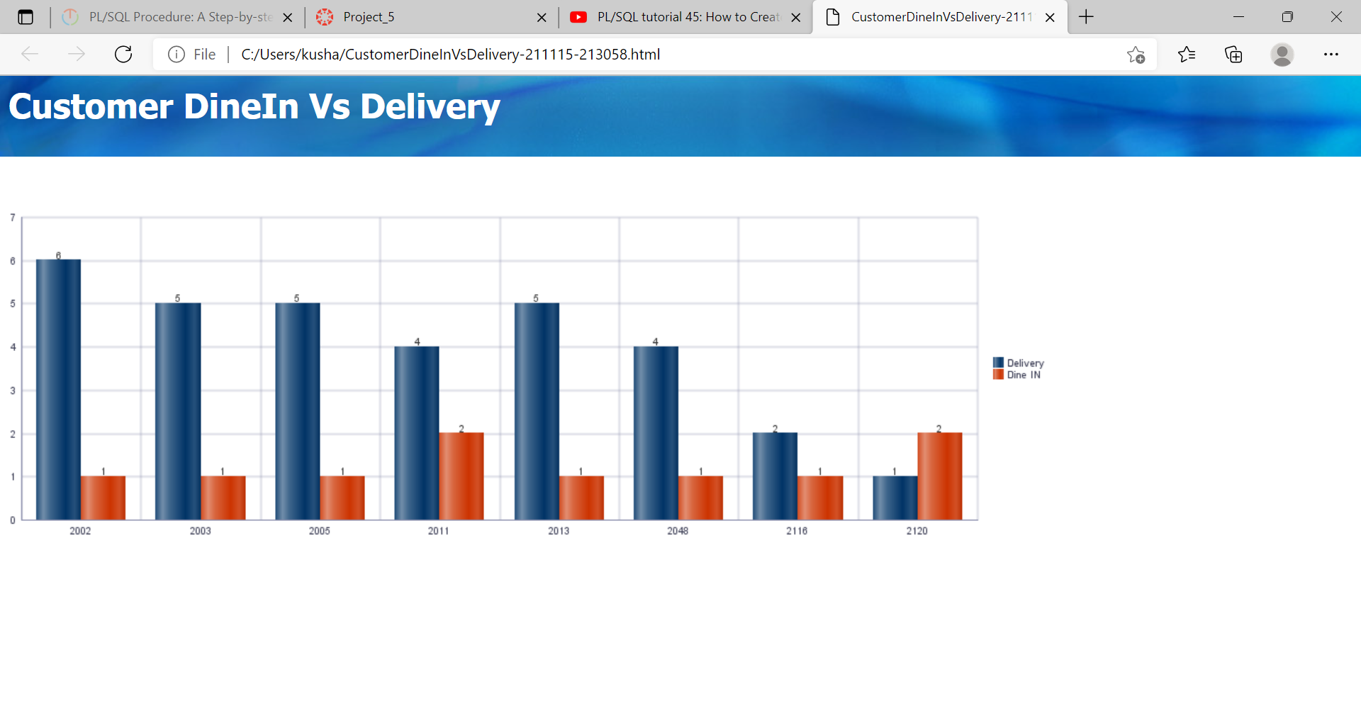
Customer DineIn Vs Delivery

Slide 22
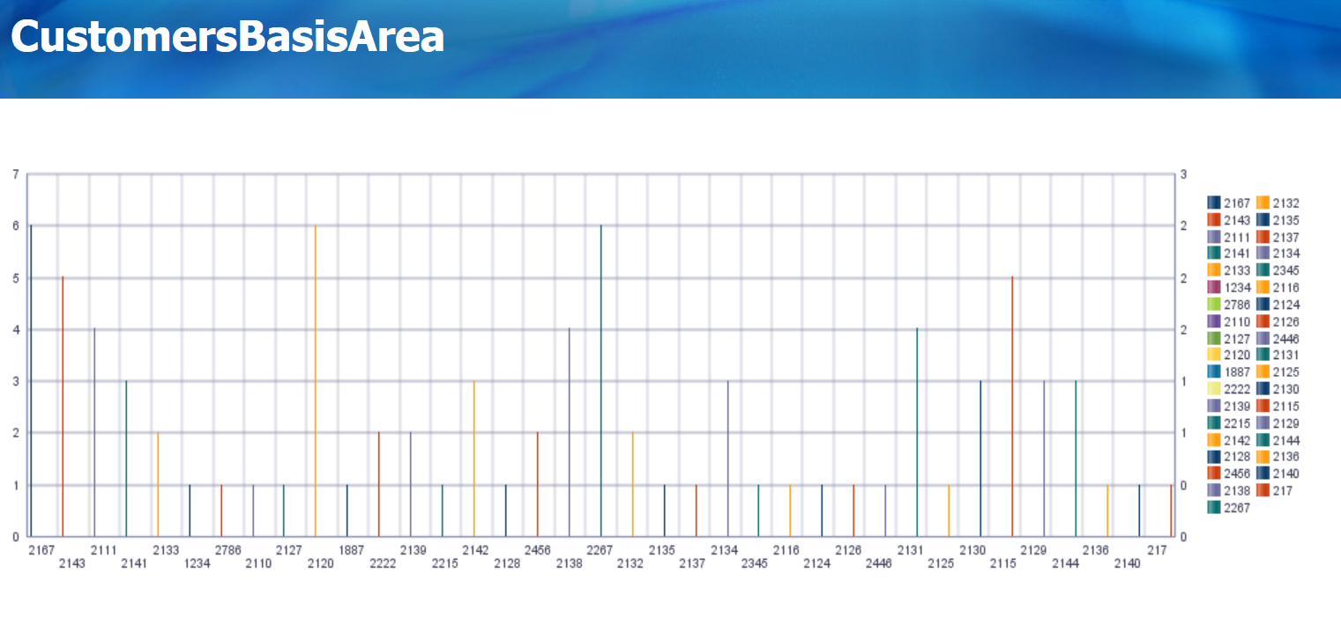
Customer Analysis Basis Area

Slide 23
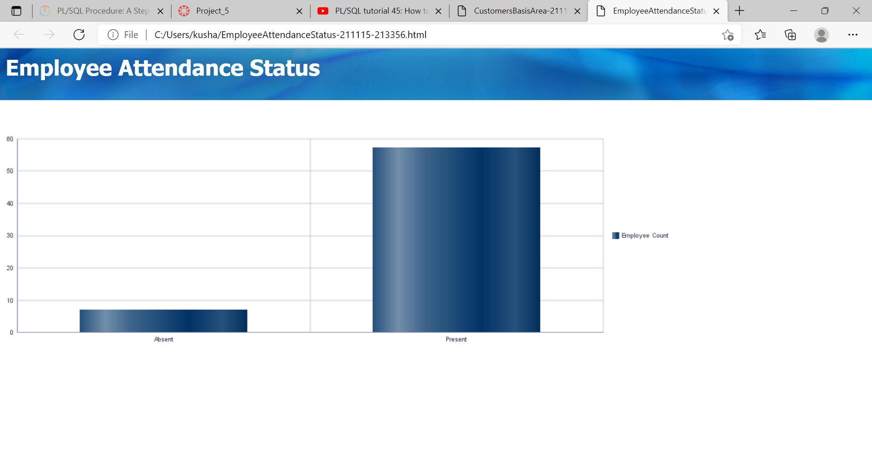
Employee Attendance Status

Slide 24
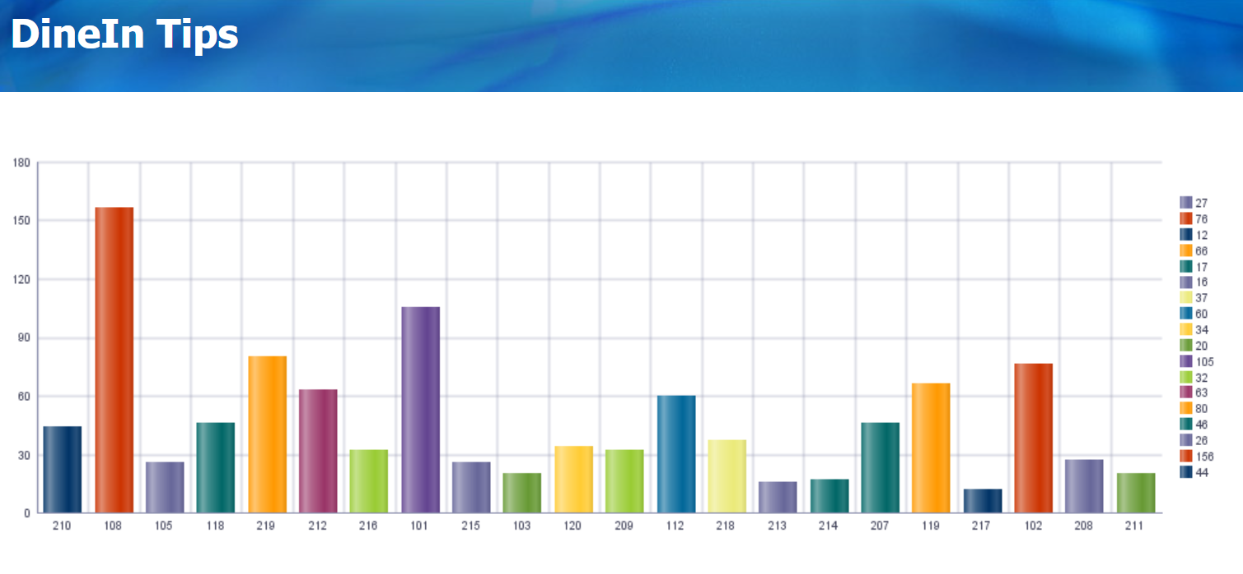
DineIn Tips

Slide 25
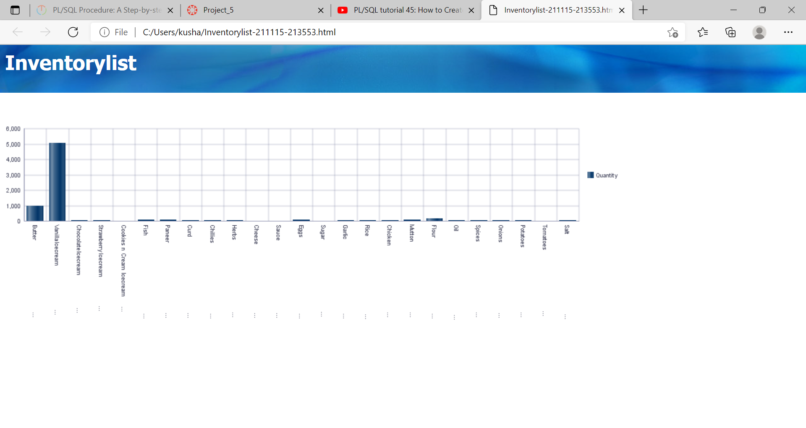
InventoryList

Slide 26
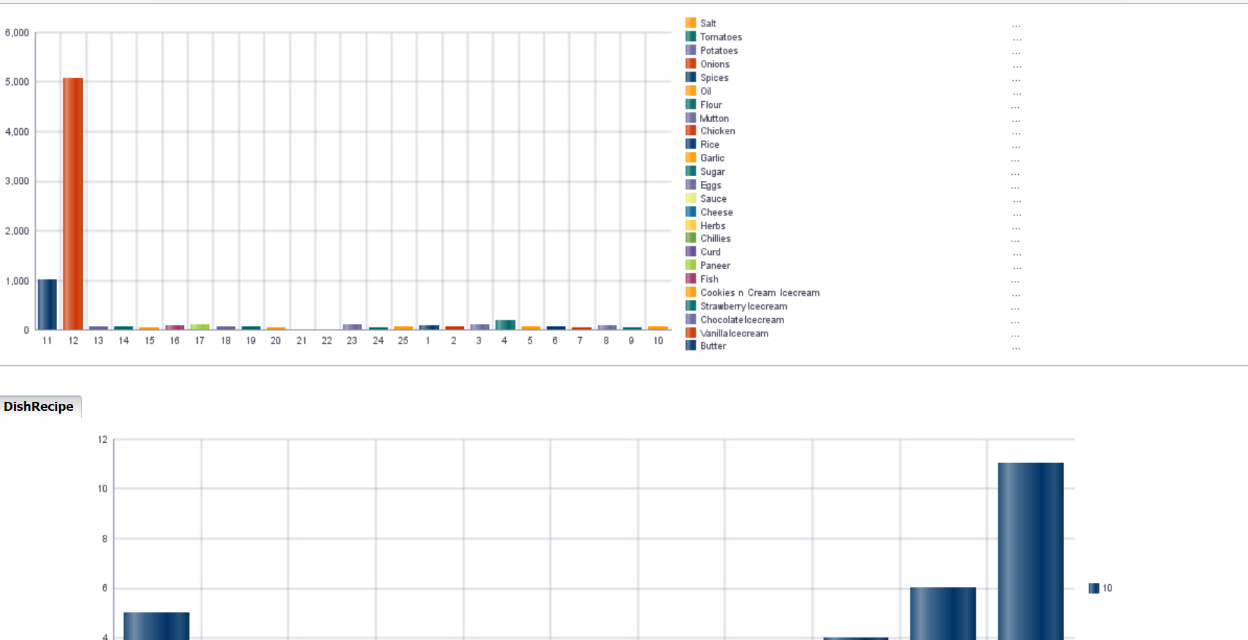
Inventory Report

Slide 27
Questions ?

Slide 28
Thank You

